Slide 1



Red Team Techniques for Evading, Bypassing, and Disabling MS Advanced Threat Protection and Advanced Threat Analytics
Notes:
So fun fact, this was the IBM Toronto downtown datacenter in 1963... I think it’s now a sushi place.

Slide 2

Whoami
@retBandit
Red Teaming Ops Lead, IBM X-Force Red
Part of CREST (crest-approved.org)
I like mountain biking, drones, and beer
Canadian, sorry not sorry

Slide 3

Why ATA and ATP?
Notes:
So why this talk on Microsoft Advanced Threat Analytics and Advanced Threat Protection?
When you’re testing very mature companies, I’ve come up against some good detection strategies at clients recently that have integrated tools like Sysmon, Applocker, EMET, event log forwarding,
products like Crowdstrike and Cylance for host behavior analytics, products like Rapid7 UserInsights for domain behavior analytics etc., and i’ve spent a lot of time figuring out how to bypass or evade them as a whole.
When I saw that Microsoft was coming out with host and domain based behavioral analytics tools, and that Advanced Threat Protection was built-in directly into Windows 10. I knew this was an area that needed more focus, especially that both products are currently in the process of being integrated.
I gave the original version of this talk at Defcon, which was first talk I’m aware of on evading and bypassing ATP, and I believe only the 2nd on ATA, as Nikhil has just presented on ATA two days earlier. Since then I’ve removed some techniques they’ve fixed and added a few more.
There’s probably lots of techniques I never tested or didn’t think of, so hopefully this inspires you to try and rip these apart yourself!

Slide 4
TTP
External Recon
Host Recon
Lateral Movement
Passive Information Gathering
Active Information Gathering
Port Scanning
Service Enumeration
Network/App Vuln Identification
Host Recon
Host Controls/Logging Recon
Host Controls Bypass
Tools Transfer
Short-Term Persistence
Host Privilege Escalation
Credential Theft
Evade Network Security Controls
Lateral Movement
Network Exploitation
Elevate Network Privileges
Gain a Foothold
Internal Recon
Dominance
Exploit Vulnerabilities
Spear Phishing
Social Engineering
Malicious USB Media
Wireless
Physical
Network Recon
Domain Recon
Asset Recon
Admin Recon
Network Security Recon
Gain Domain Admin
Gain Asset Admin
Sensitive Asset Access
Exfill Sensitive Data
Long-Term Persistence
Notes:
So to set the stage, when I developed our TTP or Tactics, Techniques, and Procedures for red teaming, I put an emphasis on host and internal recon being very distinct phases, and you’ll see why when we start to deal with products like ATP and ATA.
To become better red teamers and operate against mature blue teams, we need to gain a solid understanding of what IOCs our tools and techniques are leaving behind,
what commands may be caught by different script logging, what’s flaggable by Sysmon,
and importantly, how we can learn to use techniques that can avoid user behavior analytics

Slide 5
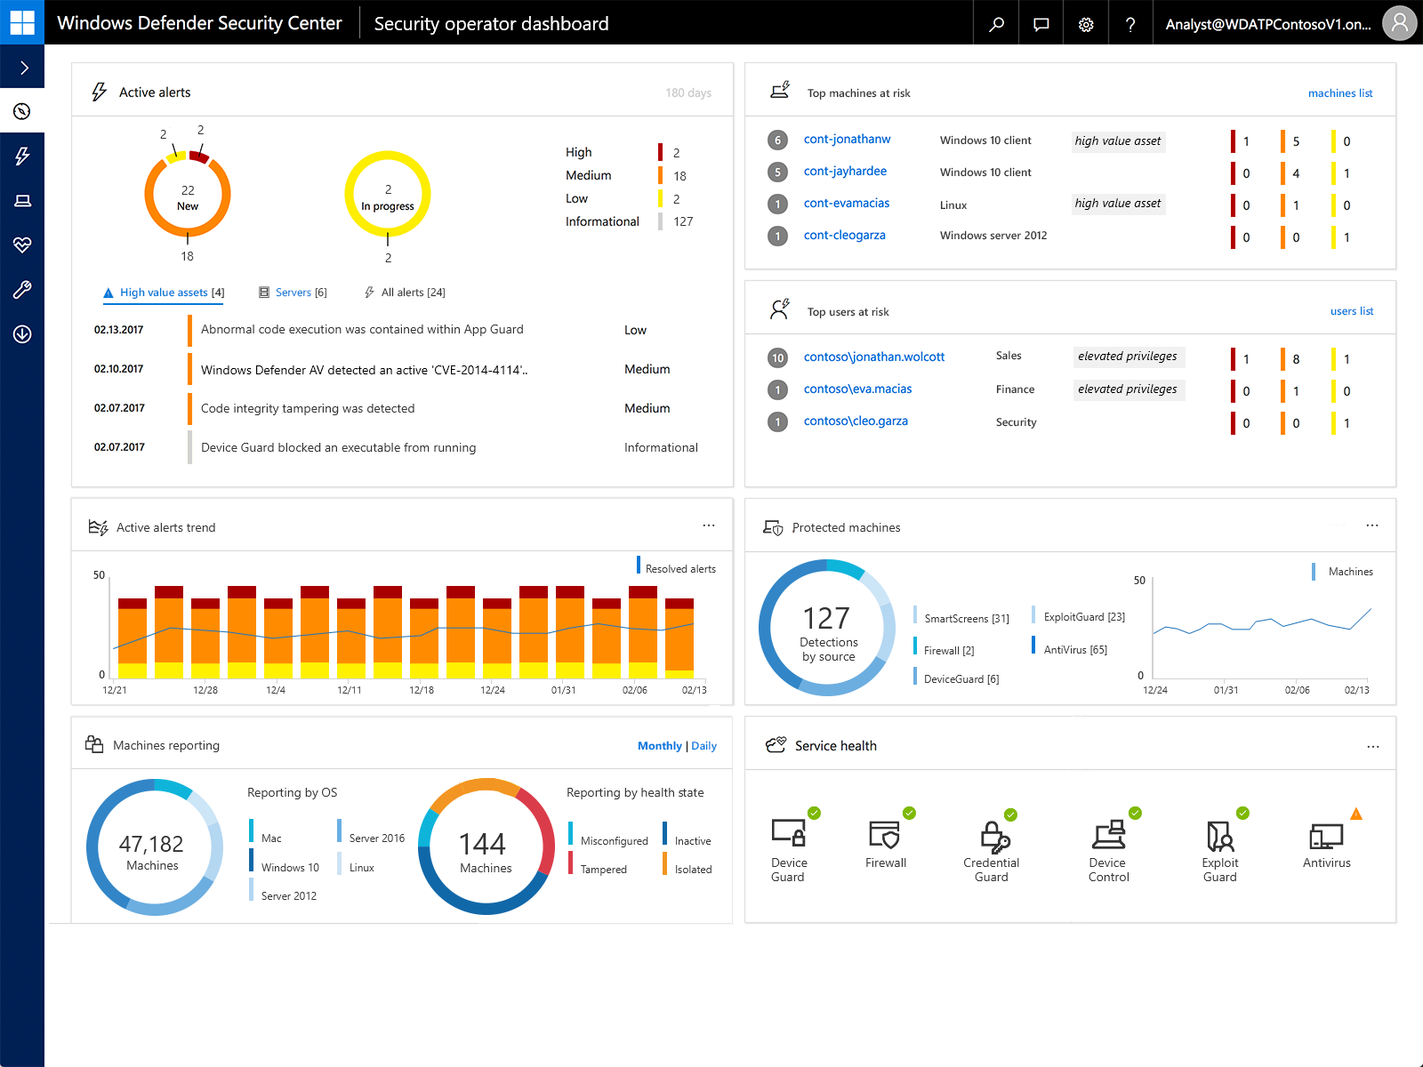
Notes:
Quick overview of ATP, which is currently activated on more then 2 million devices according to MS, and I’m pretty sure ore of those are at MS. This is the cloud dashboard all ATP sensors report in to. ATP provides cloud security analytics of data sent from ATP host behavioral sensors, similar to products like Crowdstrike.
The difference is these sensors are embedded in Windows 10 Enterprise. The second release of ATP is built-in into the last 1703 Creators Update, and Release 3 was bundled with last month’s Fall update, or Win10 1709.
These sensors collect and process behavioral signals from the box (for example, process, registry, file, and network communications) and send this sensor data to your cloud portal, which is then analyzed in the cloud.

Slide 6
Release 3 (October 17th)
Defender “brand” expanded to include:
Windows Defender Antivirus
Windows Defender Advanced Threat Protection
Windows Defender.... Exploit Guard
... Application Guard
... Device Guard
... Credential Guard
More OS
Source: https://blogs.windows.com/business/2017/06/27/announcing-end-end-security-features-windows-10/
Notes:
So as of last week’s Windows 10 Fall Creators (1709) Update w/ ATP Release 3
The Windows Defender “brand” now includes:
Defender AV
Advanced Threat Protection
The beloved EMET is back as Windows Defender Exploit Guard
Application Guard
Device Guard
Firewall
Credential Guard
greater script inspection across VBscript and Jscript
RS3 was expanded to cover the Windows Server platform, starting with Windows Server 2012 R2 and 2016, and some Linux OS, however ATP will not provide optics into the Linux sub system in RS3.
Deep integration with ATA is also coming early next year.

Slide 7
Notes:
If we take another look at the Release 3 dashboard in the bottom right corner, which takes all of those previously separate, locally monitored security tools to the cloud, integrated with Microsoft’s Security Graph behind a “single pane of glass”.
So keep in mind, this is built-in to Windows 10, activated with an E5 license or part of Microsoft 365 for Enterprise offering.
This makes adoption a lot easier for sysadmins and blue teams that were previously relying on a handful of separate products that used sysmon and windows event log forwarding, etc., with varying degrees of success depending on the maturity of their IR process.
As red teamers, we’ll need to adapt our techniques as you’ll see in the next bit.

Slide 8
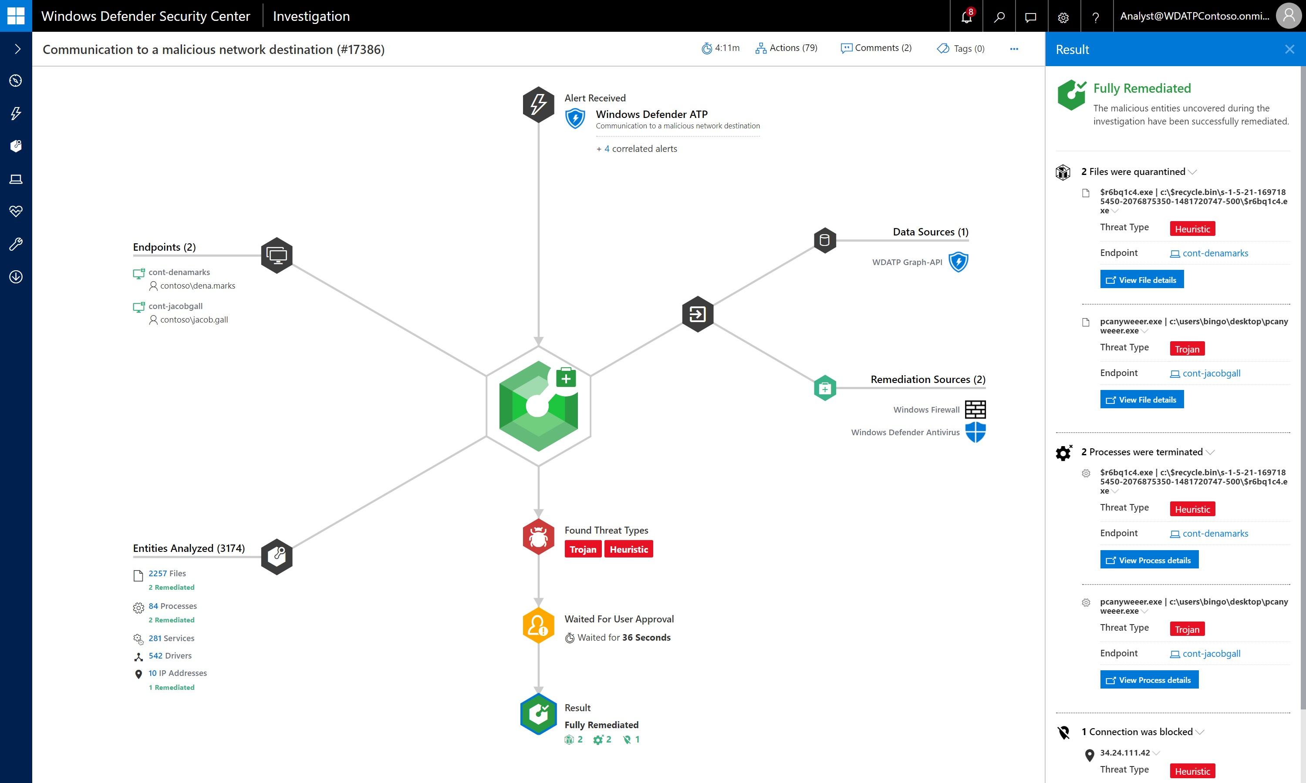
Notes:
Coming in Release 4 this Spring, Microsoft’s integrating tech from their Hexadite acquisition as well as further integration with the Security Graph and improvements for WMI logging.
What this means is we’ll start to see remediation capabilities built-in, from automatically quarantining boxes that lateral movement was identified, to automatically blocking C2 domains from Windows Firewall, etc.
So from that one infection, ATP analyzed thousands of files, services, and IPs between the two devices it new the malware was on, then auto remediated the infection.
So far from automating defenders out of a job, I think it will help smaller teams augment their Blue Teams and allow them to focus on learning how to detect more advanced attackers that will be looking to evade, degrade, and block these new capabilities.

Slide 9

Gaining a Foothold
Notes:
So let’s actually look at Advanced Threat Protection in play.

Slide 10
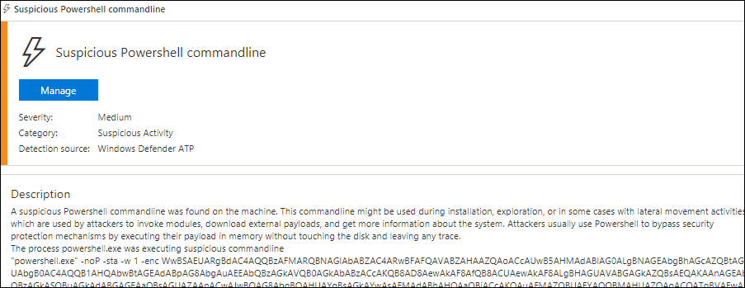
Gaining a Foothold w/ Out Of The Box PS Payloads
Notes:
Let’s start with PowerShell. ATP will detect PowerShell download cradles and launchers auto generated by Empire/Cobalt/etc.

Slide 11
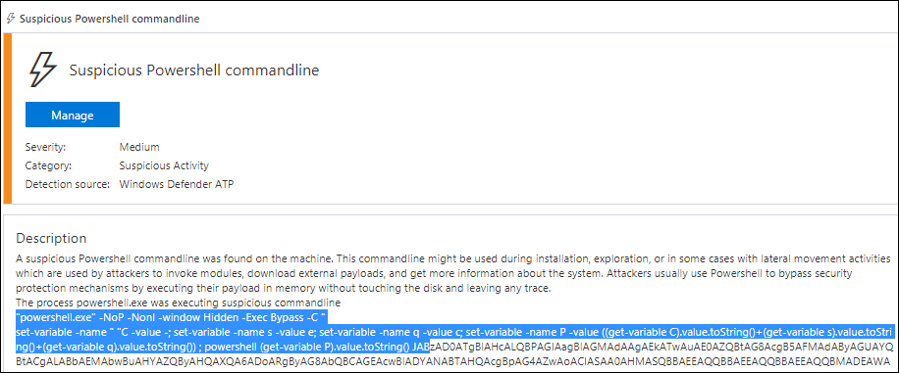
Obfuscated PS Payloads
Notes:
ATP will also detect heavily obfuscated PowerShell commands and download cradles, such as the below custom cradle with a Cobalt reverse DNS payload, or those created by the Obfuscated Empire project.

Slide 12


They promised us freedom.
Notes:
So Microsoft gave us an amazing framework with PowerShell. Attackers have been favoring using PowerShell.exe, PowerShell core, and the underlying Windows Management Framework for several years due to it’s flexibility and ease of use.
We’ve seen awesome tools and frameworks come out using PowerShell, such as Empire, PowerUp, UnmanagedPowerShell, PowerSploit, Nishang, PowerView, UserHunter and BloodHound.

Slide 13

But delivered slavery.
Notes:
But now they are trying to take away our shiny new PowerShell tools away by building this post exploitation tool that leverages all of the security improvements built-in into PowerShell (Windows Management Framework) version 5 to detect these tools in use.

Slide 14
ATP is a Beneficiary of WMF 5 / Win10 1703 Security Improvements
Window Management Framework (“PowerShell”) 5.1 provides:
PS Script Block Logging
PS Transaction/Transcription Logging
PS “Suspicious Strings”
PS Constrained Language Mode
Just Enough Admin (JEA) support
Notes:
So ATP Leverages Recent PowerShell version 5/ Windows 10 security improvements.
Due to time constraints I won’t cover these in detail, but if you really should already be familiar with them if in a red or blue team.
Window Management Framework 5.1, which PowerShell.exe is an interface to provides:
PS Script Block Logging
PS Transaction/Transcription Logging
Detection of common PS “Suspicious Strings”
PS Constrained Language Mode
Just Enough Administration support

Slide 15
ATP is a Beneficiary of WMF 5 / Win10 1703+ Security Improvements
Can’t downgrade to PSv2
System-wide transcripts
Common techniques leveraging WScript.Shell, etc. are also caught.
Can’t just use NotPowerShell (NPS) or call directly as still forced to use WMF 5
Bypasses exist but must be chained just right
Notes:
So a typical way to bypass PS script block and transcription logging is to downgrade to PSv2, but .Net 2.0 is not enabled in 1703 by default, and is actually not supported altogether in the Fall Creators Update
System-wide transcripts
Common techniques leveraging WScript.Shell, etc. are also caught.
Same goes for using Ben10’s NotPowerShell or those that directly call System.Management.Automation.dll directly as forced to use WMF v5.
We’ve seen bypasses for a lot of these, like cobbr’s PSAmsi tool, or different COM techniques, but red teamers will to need to really streamline techniques/chaining them all together to avoid alerts to get a foothold on the box initially.
As a result of these improvements, we need to go back to living off the land, selectively running PowerShell when we’re confident we’ve disabled or can silently evade these new security capabilities.

Slide 16
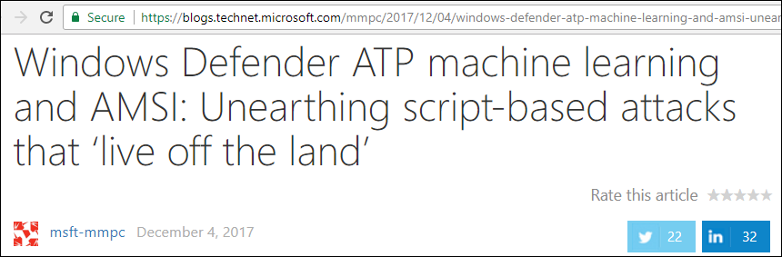
AMSI
Notes:
ATP leverages client-side AMSI detections for PowerShell, with improvements for JavaScript & VBScript in RS3
AMSI basically hooks Windows Scripting Host before the interpreter runs code in order to catch dynamic Java, VBscript, and PowerShell code being executed, after it’s been de-obfuscated.

Slide 17
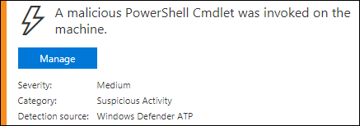
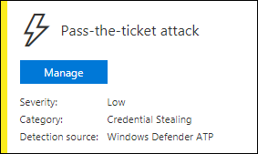
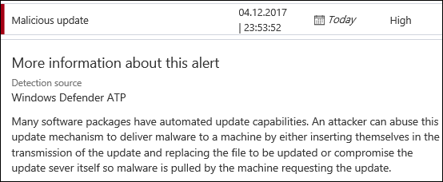
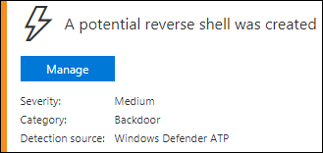
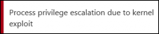
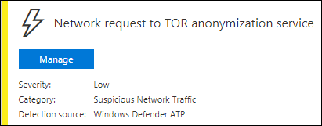
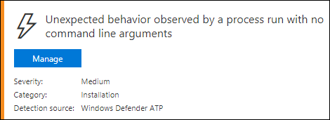
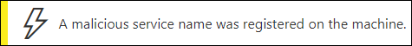
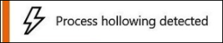
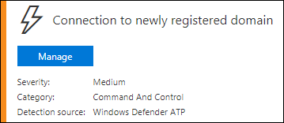
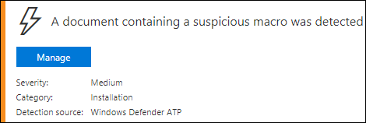
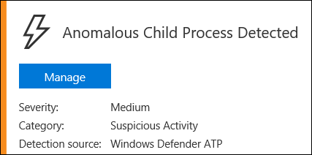
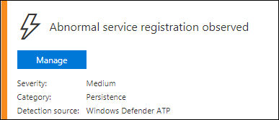
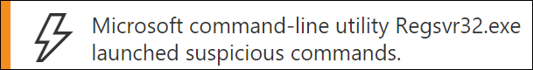
Defender ATP ≠ Defender AV
Notes:
It’s also pretty good at detecting using signed binaries to launch malicious executables based on abnormal behavior like connecting out over HTTP or Tor, using vbscript within a Macro-enabled document, etc.
So you can see based on some of these alert examples that many of the initial execution, host recon and privilege escalation activities are going to be flagged due to the common underlying techniques used.

Slide 18
Not Detected: Misc. Techniques to Gain Initial Foothold
Obfuscated JScript/VBscript payloads that don’t use Kernel32 API declarations (such as @vysecurity’s CACTUSTORCH)
Using signed exec’s to load a Cobalt stageless payload, i.e.; “rundll32 foo.dll,Start”
Some executables created with Veil (go-based) and Shellter
https://www.mdsec.co.uk/2017/07/payload-generation-with-cactustorch/
https://cobbr.io/ScriptBlock-Warning-Event-Logging-Bypass.html
Notes:
While you can get on a box using all those other methods, the name of the game is to not get caught so early.
That said, you can go undetected initially with:
Obfuscated javascript/vbscript payloads that don’t have Kernel32 API declarations
Using signed exec’s to load a Cobalt stageless DNS-based reverse payload,
Executables using av bypass techniques created with Veil (go-based) or Shellter, as long as they don’t connect out to newly registered domains or use Tor.

Slide 19

Remember, we’re talking POST Breach
Notes:
The challenge doesn’t stop by getting on the box undetected initially... that’s the easy part. The problem is detection of activities performed, tools/commands run after you have an initial foothold / C&C:
New Process Creation
Host Recon of environmental settings, local groups
Attempts to bypass Host Controls such as any logging or preventative controls like UAC, AppLocker, EMET, PowerShell Constrained Mode, PowerShell Logging, AMSI, Windows Event Log Forwarding, Sysmon, etc.
Local Host Privilege Escalation techniques by abusing unquoted service paths, exploiting vulnerable service or apps, etc.
Attempt to establish elevated host persistence to survive reboots, logging out, etc.
Then you can move onto later phases.

Slide 20
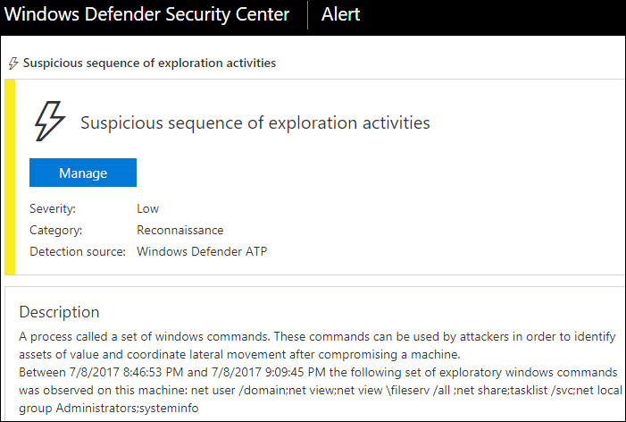
Host Recon
echo %userdomain%
echo %logonserver%
echo %homepath%
echo %homedrive%
net share
net accounts
systeminfo
tasklist /svc
gpresult /z
net localgroup Administrators
netsh advfirewall show allprofiles state
systeminfo
$env:ComSpec
$env:USERNAME
$env:USERDOMAIN
$env:LOGONSERVER
Tree $home
Notes:
So Red Teamers, these host-recon commands look pretty standards yeah? Their all out of Mitre’s ATT&CK and JCERT, etc.
They are pretty much all caught by ATP if issued in the same 24 hour period.
Depending on the method you use to create new processes to run these commands, they may also be flagged.
So instead of waiting 24 hours, we need a faster way to collect host info.

Slide 21
Not Detected: WMI
wmic process list brief
wmic group list brief
wmic computersystem list
wmic process list /format:list
wmic ntdomain list /format:list
wmic useraccount list /format:list
wmic group list /format:list
wmic sysaccount list /format:list
wmic /Namespace:\\root\SecurityCenter2 Path AntiVirusProduct Get *
Get-WmiObject -Class Win32_UserAccount -Filter "LocalAccount='True’”
Notes:
Currently, WMI queries aren’t flagged on in ATP, though reportedly in the Spring RS4 these should be be, as WMI logging is pretty easy to do but disabled by default.
You can call Windows Management Interface via the WMI command line with WMIC, or you can call the WMI schema directly using different classes, etc.

Slide 22
Not Detected: Host Recon Directly Using Windows API’s
Host-only info gathering directly calling Window’s APIs through raw sockets, Metasploit railgun, etc.
Use MSF modules with (local) API calls, such as file_from_raw_ntfs.rb
Don’t use MSF modules like local_admin_search_enum.rb
CobaltStrike has a number of modules that are API-only
Notes:
Also not detected by living off the land, using Host-only info gathering techniques that directly call Window’s APIs through raw sockets, meterpreter, etc. (such as Metasploit post modules that use Windows API’s via railgun)
You want to inspect Metasploit modules first to make sure their only using (local) API calls, such as file_from_raw_ntfs.rb
Don’t use modules like local_admin_search_enum.rb that also use cmd_exec, communicate with DC’s, etc.
CobaltStrike has a number of modules that are API-only

Slide 23
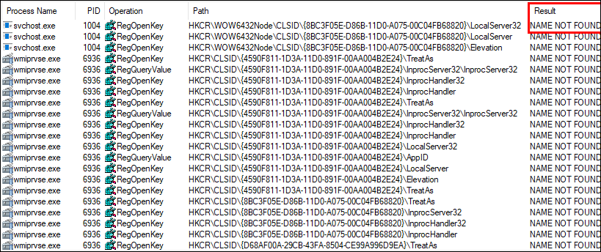
Not Detected: Userland Persistence and AMSI Bypass via Component Object Model (COM) Hijacking
HKLM (admin/system only)
+
HKCU (any user)
=
HKCR
More info by subTee and enigma0x3: https://www.slideshare.net/enigma0x3/windows-operating-system-archaeology
Notes:
So last month I had just watched SubTee (Casey Smith) and enigma0x3’s (Matt Nelson)’s talk at Wild West Hacking Fest around COM Object Hijacking, and it got me curious to look at if ATP itself was vulnerable.
Fast forward a few hours and several drinks with them later and I found several new COM hijacks to get various processes to not only run our malware for us, but as as an non-admin user gain persistence for that malware that survives logouts and reboots.
So what is COM? For the sake of time I won’t go into detail, but you can look at James Forshaw’s Troopers talk this year or the Windows Archeology talk by Casey and Matt. All you need to really know is that when a process loads, it uses COM to register and reference objects and settings within the Windows registry.
There are references several registry hives that COM uses when resolving objects:
There’s HKey Local Machine (or HKLM) that only admins can modify.
There’s HKey Current User (or HKCU) which any user can write to
And then there’s this combined kind of virtual version of the two called HKey Current Root, which is populated when the user logs in.
So if we can find instances where COM is loading from Hkey Current User first, or is referencing an object within Hkey Classes Root that doesn’t exist, we as an unprivileged user can create those missing registry keys and have that process run our malicious payload.

Slide 24
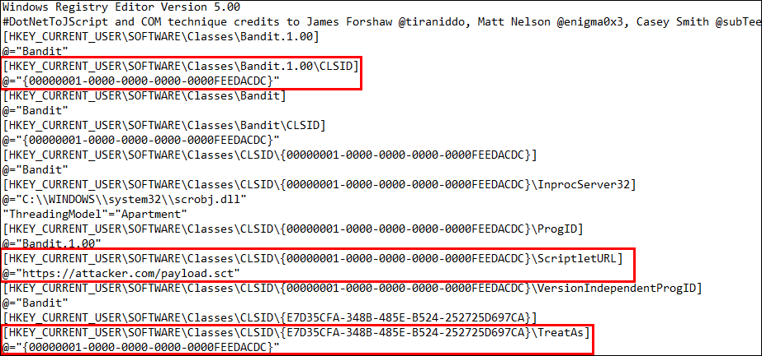
Userland Persistence via Component Object Model (COM) Hijacking
Notes:
So here’s how we abuse this
We’re defining a new COM Class ID within HKCU, as well as defining a COM Scriptlet URL for the class, which is an XML file that contains our payload written in VB or Jscript
3. Then we’re creating a Key within HKCU that corresponds to the missing key that will be populated into HKCR,
And that TreatAs key references that malicious class we created, but we could also use Inprocserver

Slide 25
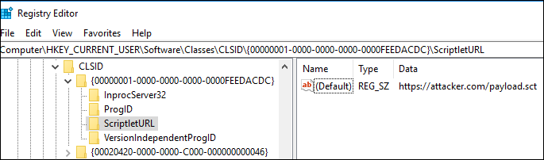
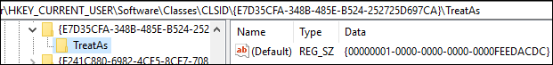
Userland Persistence via Component Object Model (COM) Hijacking
Notes:
And here’s a simplified view of the results showing the new COM ClassID, URL to the COM Scriptlet or malicious XML payload containing DOTNetToJscript, and the key we place within Hkey Current User that will be populated into the Hkey Current Root hive the next time the user logs in.

Slide 26
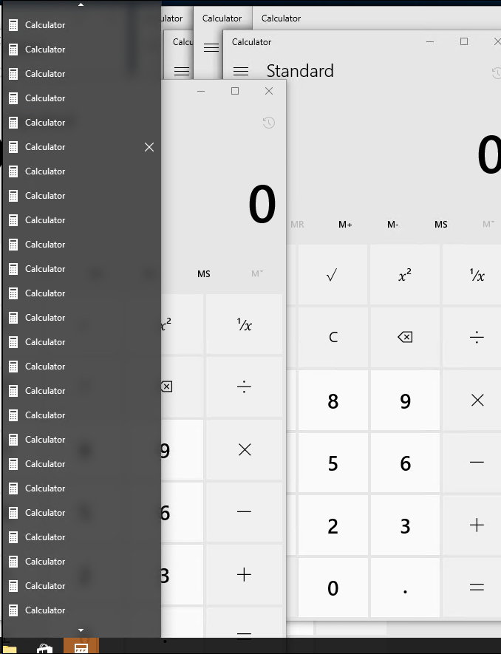

No AMSI
=
No Alerts
https://www.slideshare.net/enigma0x3/windows-operating-system-archaeology
Notes:
And now even after a reboot, various processes will load our malicious payload for us such as those created with DotNetToJScript and as well as as give us persistence on the box in userland.
Or in this case, like a 50 instances of calc for testing if you hijack all every medium-integrity process that calls to this missing COM Object.
Matt and Casey covered a few COM hijack techniques we can use to bypass command line logging and AMSI, and thus ATP alerts. As AMSI only triggers on eval/dynamic script creation for WSH, so those improved VBScipt and Jscript detections ATP leverages won’t apply.

Slide 27

Taming the beast
Notes:
We’re at a point where we have persistence on a box, and we can run our malicious code and use techniques to look without detection, as long as we’re sticking to the techniques outlined.
But what if we want to kill ATP altogether so we don’t have to be so careful?

Slide 28
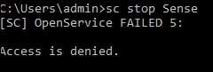
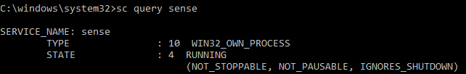
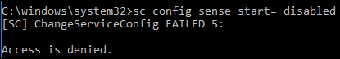
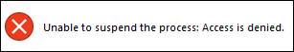
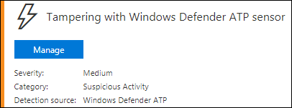
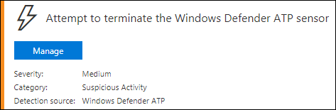
Can’t Stop ATP Process, Service, Etc., Even If Running As System*
Notes:
So if we look at more common AV/PSP bypass techniques, most these won’t work.
As an admin, you can modify the registry to disable the Sense service, but that won’t take effect until the next reboot.
As an admin you could also modify file permissions on log files, but this is very noisy and easy to detect.

Slide 29
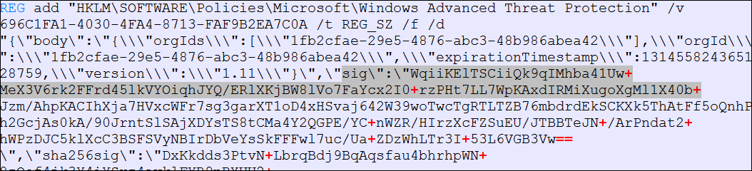
Uninstalling
Unlike other PSP/cloud AV products like CrowdStrike, you can’t just uninstall them from an elevated command prompt.
wmic product where "description='CrowdStrike Sensor Platform’” Uninstall
ATP requires a generated offboarding script with a SHA256 signed reg key:
Notes:
Unlike other PSP/cloud AV products like CrowdStrike, you can’t just uninstall them from an elevated command prompt. ATP requires a generated offboarding script with a SHA256 signed registry key based on the unique Org ID and certificate to uninstall.

Slide 30
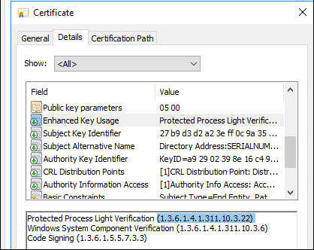
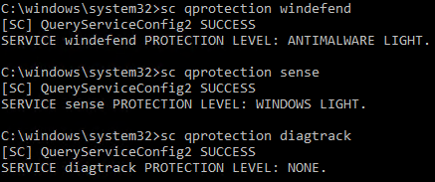
“Protected Process Light”
Notes:
The reason you can’t stop even as system is due to Protected Process Light,
PPL is a mechanism introduced in Windows 8.1 that transfers many of the security restrictions applied to the System process to user mode processes.
The binary is signed by a Windows cert with the Windows PPL Verification extended key use property.
After the service is launched as protected, Windows uses code integrity to only allow trusted code to load into the protected service. 1703 also added a new 'binary signature policy' process mitigation type that should make it more difficult to inject non-MS signed code into a protected process.
If you want to know more about PPL, Alex Ionescu has extensively covered PPL in older blog posts, but until now, we haven’t seen PPL’s widely implemented.

Slide 31
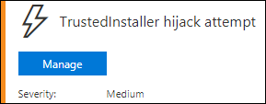
PPL Bypass
Defender AV service can be stopped/deleted via Project0’s privileged Antimalware PPL bypass:
sc config TrustedInstaller binPath= "cmd.exe /C sc stop windefend && sc delete windefend" && sc start TrustedInstaller
... since RS2, ATP (MsSense.exe) runs now at a Windows PPL protection level instead of a AntiMalware PPL, and the process is configured as “NOT_STOPPABLE”
Notes:
Defender AV service can be stopped/deleted via James @ Project0’s privileged Antimalware PPL bypass, which leverages permissions of Trusted Installer.
... since RS2, ATP runs now at a Windows PPL protection level instead of a AntiMalware PPL, and the process is configured as “NOT_STOPPABLE”
Windows 10 Fall Update brought PPL process protection to many Windows 10 sensitive processes, including LSASS and other Defender-branded security products. We’ll come back to PPL’s, but let’s look at how the ATP sensor communicates to Microsoft’s “Intelligent Security Graph”.

Slide 32
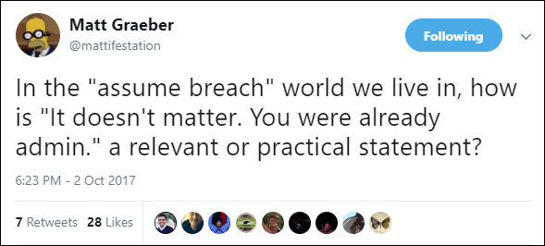
Notes:
I really like this quote of Matt’s, and it can apply to different activities along the kill chain. A lot of bypass techniques rely on having privileges on the box.
While Defenders can do their best to reduce the number of users with local admin privs and harden their box, it’s inevitable that at some point in the future,
an attacker will phish that user with an exploit or technique your org didn’t patch in time, or will some configuration abuse to become local admin.
It’s extremely important that Defenders implement redundant detection controls on a box so that if an attacker manages to evade or disable your next-gen AV agent on the box, they create enough noise in the process that if you’ve implemented free tools like Sysmon, configured Powershell and WMI logging, and forward specific events with Windows Event Forwarding, you stand a higher chance of catching them.
So with that said, here’s some privileged techniques for disabling ATP.

Slide 33
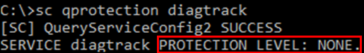
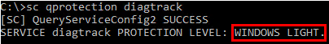
Block ATP Comms via DiagTrack Service (Privileged)
1703/ATP Release 2:
1709/ATP Release 3:
Notes:
In Release 2, While we couldn’t stop the ATP Sense service as it’s running a Windows PPL protected process, Diagtrack was not a PPL, and could be stopped by an elevated user, killing communication to the ATP cloud.
In Release 3, they’ve made Diagtrack, Windows Firewall, and other sensitive services protected processes,

Slide 34
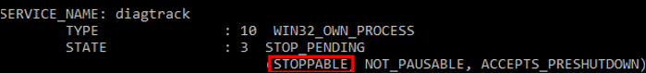
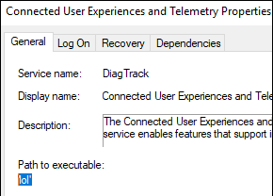
Block ATP Comms via DiagTrack Service (Privileged)
sc config TrustedInstaller binPath=
"cmd.exe /C sc stop diagtrack & sc config diagtrack binPath='lol'" && sc start TrustedInstaller
Notes:
However they didn’t flag DiagTrack as NOT_STOPPABLE, so we can still kill the telemetry service.
It’s important to also change the path or the service too otherwise it will be restarted by ATP.

Slide 35
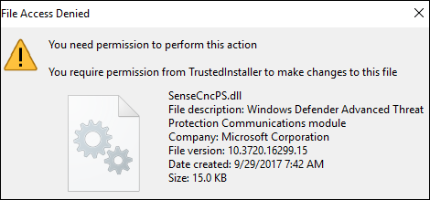
Can’t Rename The WDATP Binaries As Admin….
Notes:
As an admin, we don’t have permissions to rename or delete the ATP binaries

Slide 36
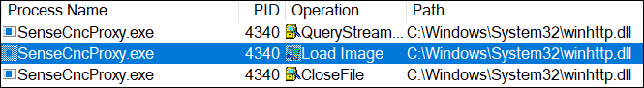
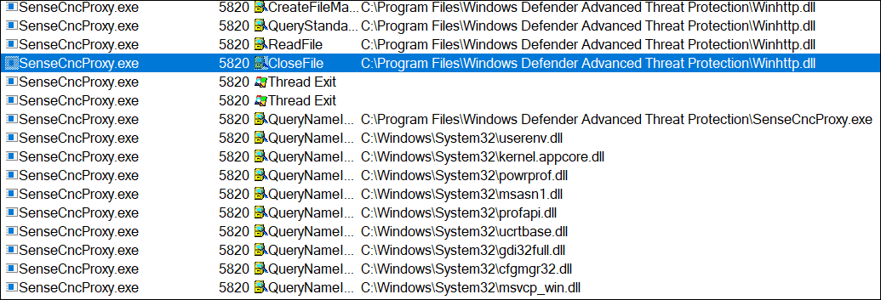
…But We Can Hijack It’s DLLs (Privileged)
Notes:
ATP first looks for key DLL’s, such as the Windows HTTP Services it uses to communicate to the cloud, within it’s own program folder, instead of the proper location in System32.
We can hijack the execution flow and prevent ATP’s communication executable Sense CncProxy from communicating with the cloud, and after reboot, will prevent ATP from starting at all.

Slide 37
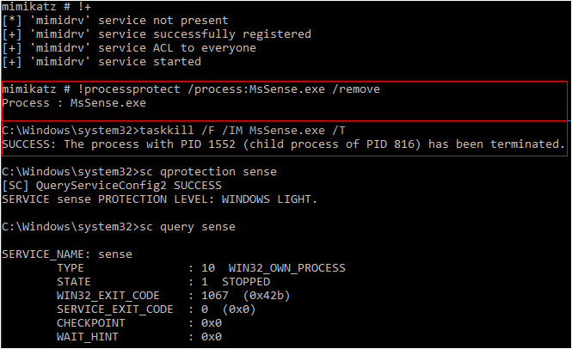
Remove PPL Protection, Kill Process (Privileged)
Notes:
I saw there was a not well documented PPL removal function in mimikatz that allowed for removing PPL protection, originally intended so you could inject into the protected LSASS process and dump creds. It uses a kernel mode driver to target PPLs.
The Sense service is still listed as “Not_Stoppable”, but if you use task kill you can drop the process after you remove process protection.

Slide 38
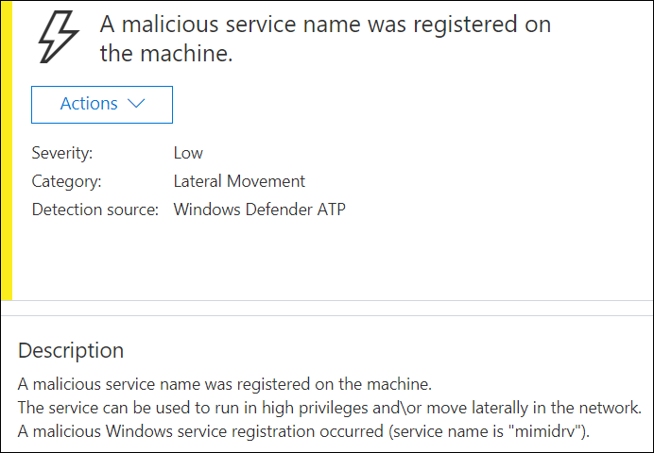
Mimikatz Driver’s Service Registered As Malicious Now…
Notes:
But Microsoft now alerts on the mimikatz kernel module registering as a service.

Slide 39
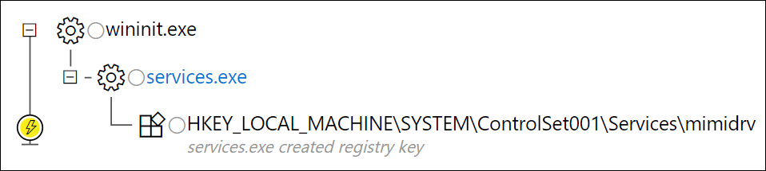
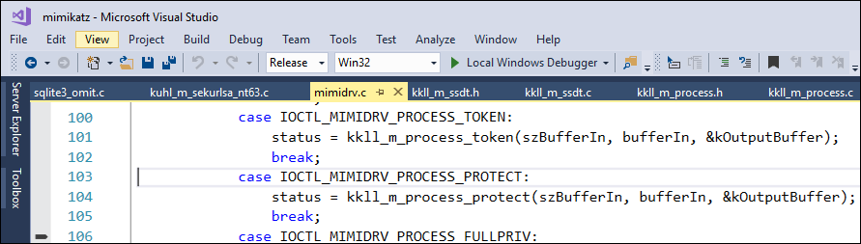
…But We Can Change The Service Name And Re-sign
Notes:
We can see that ATP is alerting on mimikat’z service name.
You can modify and compile the mimikatz driver so it doesn’t register as mimidrv and that’ll prevent the alert “A malicious service name was registered on the machine.”
BUT, if you recompile MIMIKATZ, you’ll need to buy a valid kernel EV code-sign certificate and re-sign it.
Obviously IBM has loads of code signing certs, but if you don’t have one, it can be expensive and a pain to register a new company, and hard to avoid attribution with.

Slide 40
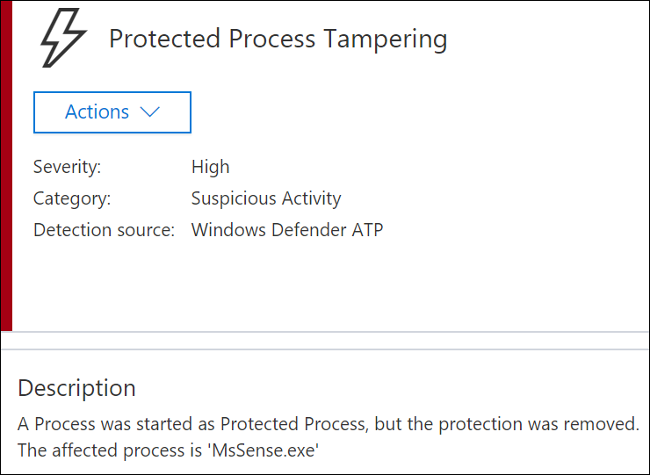
Now Also Alerts On PPL Tampering*
sc config TrustedInstaller binPath=
"cmd.exe /C sc config sense binPath='blank'"
&& sc start TrustedInstaller
Notes:
As well, ATP will now alert on PPL being removed from Sense, but only if the service can restart itself.
But we can get around the process tampering alert if you prevent WDATP from restarting after it was killed, for example with using TrustedInstaller to hijack the path, which now works as the process is not running.

Slide 41
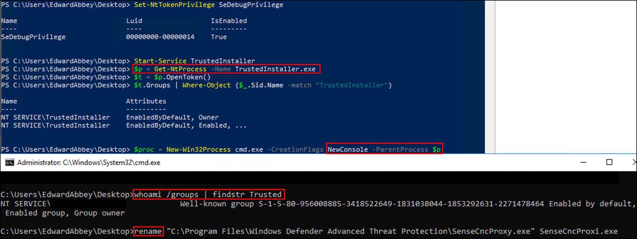
Become Trusted Installer to Target Executables (Privileged)
We can use James Forshaw’s technique to become Trusted Installer, and then rename protected ATP executables;
https://tyranidslair.blogspot.ca/2017/08/the-art-of-becoming-trustedinstaller.html
Notes:
Now that ATP alerts on the signed mimikatz kernel driver, here’s a better way::
James recently put out a technique to elevate from admin to Trusted Installer. Only Trusted Installer, not admins have permissions on the ATP folder.
Since the Sense CNC Proxy executable that communicates with the ATP cloud is only called on every few minutes, we can modify it before the next time it’s called by ATP, preventing it from running and sending out alerts.

Slide 42
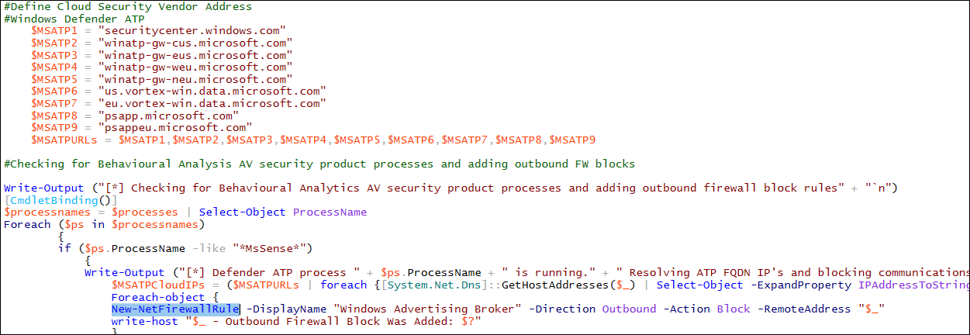
Block All Windows Defender/ATP Comms via FW (Privileged)
You can use the same (privileged) technique to block in/out traffic for WinRM, Sysmon via Windows Event Forwarding, SCOM, etc.
Notes:
So why not make Microsoft turn the gun on itself?
Here’s a snippet from some PowerShell scripts I put together. It resolves the ATP cloud hosts, then uses Windows FW to block ATP and other comms.
Because this requires elevated privileges, you’d first use the previously shown technique, then you’re free to use PowerShell tools like PowerUp to perform privilege escalation, then run this more permanent FW block.
Alternatively, you may be targeting help desk/IT staff that may have local admin privs.
You can use the same technique to block traffic to/form Event Log Forwarding, Sysmon, SCOM, etc., just based on port or service instead of IP.
They key is being able to block comms for both before an alert gets out, especially when there’s sub-second event polling in place

Slide 43

Threat Neutralized
Notes:
Personally I think Windows Firewall is the best approach to blocking as it’s
Very fast.
Can’t be fixed.
Doesn’t require escalating to system to modify file permissions or find a PPL bypass
Doesn’t require Mimikatz kernel module
Once we’ve blocked ATP, event log forwarding, sysmon, SCOM, etc., we don’t really care what we do against the local box.
The problem comes when organizations are using other products, like McAfee HIPS, which takes over Firewalling. In that case, we need to use other techniques to either remove the 3rd party firewall and reinstall Windows Firewall, or uses some of the privileged techniques shown.
Remember, this is not about logs stored on the local box: we’re more worried about blocking ATP, event log forwarding, sysmon, SCOM, etc. that alert on those logs before they tip off the Blue Team monitoring for alerts

Slide 44
Advanced Threat Analytics
“ATA captures and parses network traffic of multiple protocols (such as Kerberos, DNS, RPC, NTLM and others) for authentication, authorization and information gathering.”
Designed to Detect:
Pass-the-Ticket (PtT)
Pass-the-Hash (PtH)
Overpass-the-Hash
Forged PAC (MS14-068)
Golden Ticket
Malicious replications
Reconnaissance
Brute force
Remote execution
Weak/malicious protocol usage
Abnormal user behavior
Modification of sensitive groups
https://docs.microsoft.com/en-us/advanced-threat-analytics/what-is-ata
Notes:
So now that we’re at the point where we can comfortably run commands without being flagged by the local ATP instance, let’s look at Advanced Threat Analytics.
It’s intended to detect typical Active Directory Domain recon and credential attacks.

Slide 45

ATA On Premise Architecture
ATA relies on the following Windows events: 4776, 4732, 4733, 4728, 4729, 4756, 4757
Notes:
The On Premise version of ATA
Can integrate with SIEM (syslog) & VPN (radius).
LWG used to require Event Log Forwarding before 1.8 which I had a nice little block for... now all events read locally.

Slide 46


Coming soon...
+
+
Intelligent Security Graph
Notes:
We aren’t covering today is Azure ATP aka Azure ATA, which is in private beta.
It will soon have ATP integration from endpoints such as Windows 10, Sever 2012, and Server 2016, and that data will be correlated using machine learning via the Microsoft Security Graph.
But aside from integration with ATP, it won’t have any major changes until near the end of Q1.

Slide 47


Notes:
So here’s the ATA console showing a timeline of alerts,
with the notification bar on the right.

Slide 48

ATA Learning Period
1 month of learning:
Abnormal behavior
Abnormal sensitive group modification
Recon using Directory Services
1 week of learning:
Encryption downgrades (skeleton key, golden ticket, over pass the hash)
Brute force
Notes:
According to MS, the above periods are needed to allow for user behavior analytics.
While it’s hard to accurately test user behavior analytics, if we think about what’s it’s flagging on, we can plan accordingly.
Whenever possible, you want to perform commands from help desk or privileged user boxes,
leveraging RDP history, PowerShell history, IT bookmarks, etc. to help minimize unusual behavior being flagged.
Tom Porter’s talk on Extending Bloodhound also spoke about mapping out connections based on netstat, and a few weeks ago we were talking about also extending BloodHound to incorporate this history as well from RDP and PowerShell history.

Slide 49

Internal Recon
Notes:
So now that we’re at the point where we can comfortably run without being flagged by the local ATP instance, we’d typically start to perform Internal Network Recon, including Active Directory recon (Domains, Forest trusts, group memberships, users, admins, infrastructure)

Slide 50
Detected: Bulk DNS queries, nslookup, zone transfers
Notes:
Performing Bulk DNS queries, nslookup, zone transfers will get flagged.
You can cut down on this by not running DNS brute force tools internally like fierce, and lowering the volume of DNS queries.

Slide 51

Detected*: AD Recon using SAMR protocol or tools like “net user /domain”
Notes:
A lot of AD recon techniques are caught because they remotely connect to the DC to enumerate the info using SAM-remote protocol.
Commands like "net user /domain", performs directory services queries and by default asks for a lot of account properties.
ATA applied a learning period to this detection to cut down on false positives, but should be detected after 1 month.

Slide 52


Not Detected: Using LDAP/Powerview To Gather Computers/Users
Notes:
We can use LDAP via Powerview to grab a list of computers and group members, which is pretty normal user traffic on a domain.
Flagging on this would lead to a lot of false positives.

Slide 53

Not Detected: Enumeration via WMI Local Name Space
Domain User Accounts:
Get-WmiObject -Class Win32_UserAccount -Filter "Domain='dev' AND Disabled='False'" | Select Name, Domain, Status, LocalAccount, AccountType, Lockout, PasswordRequired, PasswordChangeable, Description, SID
Domain Groups:
Get-CimInstance -ClassName Win32_Group -Filter "Domain = 'dev' AND Name like '%Admin%’”
Notes:
These example WMI/CIM queries are ran against information already within the local computer's name space, not communicating with a Domain Controller.
This is my preferred method, as we’d avoid any potential abnormal user behavior detection improvements in the future.
Note, WMI cmdlets are PSV2+, where CIM cmdlets are PSv3+ only.
Alternatively, you can use wmic via the command line.

Slide 54
Not Detected: Enumeration via WMI Local Name Space (Cont’d)
Domain Group User Memberships:
Get-CimInstance -ClassName Win32_Group -Filter "Domain = 'dev' AND Name='Enterprise Admins'" | Get-CimAssociatedInstance -Association Win32_GroupUser
Get-CimInstance -ClassName Win32_Group -Filter "Domain = 'dev' AND Name='Microsoft Advanced Threat Analytics Administrator'" | Get-CimAssociatedInstance -Association Win32_GroupUser
Notes:
As of ATA 1.8, you can hunt for the default ATA groups to see if ATA is even in use, and who members of that group are.
To detect, monitor for Event ID 4799 in local Security Event Log, filtering on the Security ID not being system
To prevent, test out using Namespace security with WMI Control, or WMI Securable Objects to block domain users

Slide 55


Detected: Default Session Enumeration via UserHunter, NetSess
Notes:
So tools like UserHunter, and BloodHound which uses UserHunter, query servers to find all active SMB sessions to get all the users and IP addresses associated with those SMB sessions.
If you’ve ever used BloodHound you’ll see how valuable this technique is to map out an attack path to whatever account or domain member system you’re after.
By default, UserHunter first queries the DC for a list of domain member computers, which will obviously include Domain Controllers.
You’ll see in this alert the column “Against Domain Controllers”.
That tells us that UserHunter is being flagged because by default we asked the DC to tell us who currently has a session on the box.

Slide 56

Not Detected: Session Enumeration By Excluding DC’s
As of the last BloodHound 1.4 (SharpHound) release earlier this month:
Invoke-BloodHound –ExcludeDc
https://blog.cptjesus.com/posts/newbloodhoundingestor
Notes:
We can get around this by manually providing a list of computers that don’t include any DC’s by just providing a host target file manually.

Slide 57

Lateral Movement
Notes:
So now we can gather info on potential targets such as privileged users, let’s look at Lateral Movement. This typically includes:
Leveraging gathered SMB Session information, SPN info, and AD group info to target privileged accounts
And then performing remote code execution via techniques and/or remote exploits to gain access to other systems, move around the domain, and elevate our privs.

Slide 58

Detection (ATA): Lateral Movement
Usually detected (against DC’s only):
WMIexec
PSexec
May be detected due to “abnormal user behavior” against domain members:
WMIexec
PSexec
WinRM
DCOM
PSexec/SMBexec
RDP
Remote Registry
PSRemoting/WinRM
Notes:
ATA is decent at detecting PSEXEC and WMI exec against a DC
But relies purely on behavior analytics to detect unusual authentication against other domain member workstations and servers.
So there’s a gap in detection for lateral movement with ATA, especially if you can perform lateral movement from a help desk user or IT staff box,
relying on RDP or PowerShell history, existing network sessions, etc. to not be flagged as an unusual connection.
Abnormal user behavior detection gets better over time, and will be greatly improved when integrated with ATP RS3 on supported OS’s.

Slide 59


Not Detected: SPN Enumeration & Kerberoasting
Requesting/Kerberoasting SPN’s blends in as regular traffic.
Get-NetComputer -SPN mssql*
Get-NetUser -SPN | Get-SPNTicket -OutputFormat Hashcat
Notes:
Any domain user can enumerate Service Principal Names associated with service accounts, and then requesting their Kerberos TGS Tickets, which is encrypted with the accounts NTLM hash. This blends in as regular AD traffic.
Once we have the SPN tickets, we can crack them to get the password using X-Force Red’s cluster of 16 GTX 1080’s.

Slide 60
Not Detected: Silver Tickets
While a Golden ticket is a forged TGT valid for gaining access to any Kerberos service, the silver ticket is a forged TGS.
TGS is forged, so no associated TGT, meaning the DC is never contacted.
Any event logs are on the targeted server.
Source: Sean Metcalf- https://adsecurity.org/?p=2011
Notes:
So now that we have the credentials for those service accounts, we could just login to that server with those credentials, but the authentication traffic may tip off that the account was compromised.
Instead, we can create a silver ticket to authenticate against the associated target server, and our authentication request would never hit the DC.
I’d imagine now that ATP integration is coming, and ATP has some server support and is being further developed, we’ll possible see Silver Ticker detection, but I won’t hold my breath.

Slide 61
Detected: Modification of Sensitive Groups
Enterprise Read Only Domain Controllers
Domain Admins
Domain Controllers
Schema Admins,
Enterprise Admins
Group Policy Creator Owners
Read Only Domain Controllers
Administrators
Power Users
Account Operators
Server Operators
Print Operators,
Backup Operators,
Replicators
Remote Desktop Users (for DCs)
Network Configuration Operators
Incoming Forest Trust Builders
DNS Admins
Notes:
Sensitive groups
The following list of groups are considered sensitive by ATA. Any entity that is a member of these groups is also considered sensitive.
So if we modify these groups, such as adding a member, or reset the password of a member of these groups, ATA should flag on it.
But I haven’t run into a single environment where the only privileged groups are the default list above. In fact, if we follow Microsoft best practice guidance on delegating permissions, many privileged groups should exist.

Slide 62

Not Detected: Enumerating AD Access Control Entries
Selectively enumerating Active Directory object Access Control Entries (ACEs)/Discretionary Access Control Lists (DACLs) Invoke-BloodHound -CollectionMethod ACL –ExcludeDC
More info: https://wald0.com/?p=112
Notes:
With the BloodHound 1.3 attack path update, we can enumerate AD object Access Control Entries, and visualize the attack paths with BloodHound.
The problem is we’ll likely get flagged if we used a DACL escalation path to modify a Sensitive group, liek DNS Admins.
But what if we target a custom, yet very common privileged group like Help Desk or SQL Admins?

Slide 63

Not Detected: Escalation via Selective AD ACL Abuse
Selectively targeting Active Directory object Access Control Entries (ACEs)/Discretionary Access Control Lists (DACLs)
Add-DomainGroupMember -Identity sql01admins -Members edwardabbey Set-DomainUserPassword -Identity webservice -AccountPassword $Password
More info: https://wald0.com/?p=112
Notes:
We can then abuse those excesses permissions to add ourselves as non-sensitive admin groups, and then reset the password of a target account temporarily to log into a server as a user that regularly access that box.
Combined with enumerating user sessions on the target server, we can avoid being flagged by ATA for abnormal user activity, by using account that would be expected to regularly login to it.
Active Directory is working by design here, as Abbey’s account was a member of the Help Desk, which had Delegated control over Web Service, which is an admin on App01. I’d imagine this would be difficult detect accurately with ATA.
Rohan, Andy, and Will from the Specter Ops crew recently covered how to reset a user’s password back based on their password history, check that link for more info and the other great work they and Lee Christensen have done in this area.

Slide 64


Detected: Over-Pass-The-Hash (Using KRBTGT NTLM Hash)
Notes:
When we grab an accounts NTLM hash and use an Over-Pass-the hash attack to request a Kerberos Ticket, ATA flags it as an Encryption downgrade or unusual protocol implementation.
When you request a Kerberos Ticket with an NTLM hash the encryption type is rc4, but you see in these request we aren’t providing the AES keys, which would be present in a legitimate request.

Slide 65

Not Detected: Over-Pass-The-Hash (Using All Hash/Keys)
sekurlsa::pth /user:administrator /domain:prod.local /aes256:12d23a766f9bac2a6e31b3afbd4f41a2d49b336b76f1edbe3d8b2fa9c9848d4c /ntlm:4c4715b4028d7aba53130d0db3de13fe /aes128:00000000000000000000000000000000
Notes:
But if we request a Kerberos Ticket with the AES keys as well we aren’t flagged.
Interestingly enough, I found if you only had the AES256 key, but not the AES128 key, you can use any 32 characters for the aes128 key and it’s not flagged as long as the AES256 key is valid.

Slide 66
Not Detected: Lateral Movement via SQL Auth
SQL authentication events are local to the server
Target sa accounts, compromise SQL servers that have privileged AD user sessions using tools like PowerUpSQL
Cross-Forest SQL trusts can also be targeted as demonstrated by Nikhil- http://www.labofapenetrationtester.com/2017/03/using-sql-server-for-attacking-forest-trust.html
Notes:
SQL authentication events are local to the server-
Target sa accounts, compromise SQL servers that have privileged AD user sessions
Cross-Forest SQL trusts can also be targeted as demonstrated by Nikhil-
ATA’s looking for domain authentication events, strictly within it’s own Forest.
It can’t monitor separate security boundaries like other Active Directory Forests, even if there’s a 2-way Forest Trust.

Slide 67

Dominance
Notes:
So once you can access to a privileged user, it’s time to move towards achieving the primary goals of the red team engagement.
Those may include:
Dominance over the network- you may or may not need to grab the Active Directory Database, it sure comes in handy but comes with it’s own opsec challenges
Access sensitive information such as financial records or Intellectual Property
Gaining privileged access to specified systems, data, or apps

Slide 68

Detected: DCSync
mimikatz # lsadump::dcsync /domain prod.local /user:admin
Notes:
So a common technique to grab the AD database is to use DCSync,
which effectively “impersonates” a Domain Controller to send a replication request to another Domain Controller to grab credentials.
As you can imagine from a behavioral analytics perspective, this would be pretty easy to detect if running DCSync not from a DC, and will get caught by ATA if run in the same Forest.

Slide 69


Partial Detection: Copying NTDS.dit File Remotely using WMI
We can use the WMI Win32_ShadowCopy Class to dump the ntds.dit via volume shadow copies without having to call vssadmin.exe
Now flagged as a LOW severity event in ATA 1.8 due to executing Win32_process create, but not for the use of volume shadow copy:
Notes:
We can use the WMI Win32_ShadowCopy Class to dump the ntds.dit via volume shadow copies without having to call the Volume Shadow Copy admin executable directly.
This is now flagged as a LOW severity event in ATA 1.8 due to execution Win32_process create, but not for the use of volume shadow copy
ATA 1.8 may also detect by WMI exec methods but couldn’t replicate detection in lab.

Slide 70
Not Detected*: PSRemoting with LSASS Inject
PowerSploit: Mimikatz in memory w/ LSASS Injection
Invoke-Mimikatz -Command '"privilege::debug" "LSADump::LSA /inject"' -Computer dc03.prod.local
Blue Tip: Lots of ways to harden/log WinRM/PSRemoting, restrict via groups/source, etc.
Notes:
Within PowerSploit, mimikatz executed remotely on DC03 in memory via WinRM/PS Remoting is not detected
While I couldn’t reproduce it, user behavior analytics may spot PSRemoting in a prod environment.
In ATA 1.7 or earlier, event log forwarding required you enable WinRM by default on DC’s using winrm quickconfig
Blue Tip: Lots of ways to harden/log WinRM/PSRemoting, restrict via groups/source, etc.

Slide 71
Not Detected*: PSRemoting with Raw Disk Access
PowerSploit: Ninja-Copy
Invoke-NinjaCopy -Path "c:\Windows\System32\config\SYSTEM" -ComputerName "dc03.prod.local" -LocalDestination "c:\temp\system"
Blue Tip: You can detect LSASS injection/raw disk access with Sysmon
Notes:
Ninja-Copy leverages PS Remoting and raw disk access to directly copy the NTDS.dit and SYSTEM file without starting suspicious services, injecting into processes, or elevating to SYSTEM.
Blue Tip: You can detect LSASS injection/raw disk access detect with Sysmon

Slide 72

Detected: Golden Tickets Detection (Using KRBTGT NTLM Hash)
kerberos::golden /user:EdwardAbbey /domain:prod.local /sid:sid /krbtgt:rc4 /groups:513,512,520,518,519 /ptt
Notes:
So now we have the AD Database, what if we want to leverage the KRBTGT to create a Golden Ticket?
Just like Over Pass the Hash, if we use just the NTLM hash, we’ll get flagged as an encryption downgrade as it’s using RC4, and Windows is expecting the TGS_REQ to also include the Ticket’s AES key.

Slide 73


Not Detected: Golden Ticket w/ AES Key
kerberos::golden /user:JohnVanwagoner /domain:prod.local /sid:sid /aes256:aes256 /groups:512,513,519 /startoffset:-1 /endin:2500 /renewmax:3000 /ptt
Notes:
So by using the KRBTGT AES key instead, it’s not flagged as an encryption downgrade event.
ATA 1.8 did add detection for expired tickets in use, so it’s generally a good idea to use shorter ticket life spans under an hour, regenerating Golden Keys each time you need it.

Slide 74
Blue Team Takeaways
Limit PS Remoting sources to dedicated admin workstations
Use JEA (Just Enough Administration) to help prevent lateral movement success
Harden SQL servers, review forest trusts
Integrate SIEM/VPN logs into ATA
Use Event Log Forwarding for Sysmon and WMI logging with shorter polling times
Audit your AD object ACLs with BloodHound, use NetCease
Enforce AES-256, especially for service account SPNs
Enforce “Binary Signature Policy” in 1703 to help protect PPLs
Integrate those new Defender branded tools like Exploit Guard (WDEG)
Enforce EMET/WDEG’s Attack Surface Reduction (ASR) rules
Notes:
Limit PS Remoting sources to dedicated admin workstations
Use JEA (Just Enough Administration) to help prevent lateral movement success
Harden SQL servers, review forest trusts
Integrate SIEM/VPN logs into ATA
Use Event Log Forwarding for Sysmon and WMI logging with shorter polling times
Audit your AD object ACLs with BloodHound
Enforce AES-256, especially for service account SPNs
Enforce “Binary Signature Policy” in 1703 to help protect PPLs
Integrate those new Defender branded tools like Exploit Guard (WDEG)
Enforce WDEG’s Attack Surface Reduction (ASR) rules

Slide 75
Red Team Takeaways
Return to living off the land, directly call APIs
Leverage host based PowerShell tools only after you’ve blocked or disabled ATP & event log forwarding
Review RDP/PS/Session history to help avoid user behavior analytics
Block event log forwarding to prevent Sysmon/WMI/PowerShell/ Security logs giving you away
Use ACE/DACL abuse to help avoid using RCE when possible
Focus on info gathering and lateral movement techniques that don’t comm with the DC, like SQL auth and Silver Tickets
Kerberoast & Silver Ticket all the things
Use AES for Over-PTH, Golden Tickets
Abuse Forest Trusts
Notes:
Return to living off the land, directly call APIs
Leverage host based PowerShell tools only after you’ve blocked or disabled ATP & event log forwarding
Review RDP/PS/Session history to help avoid user behavior analytics
Block event log forwarding to prevent Sysmon/WMI/PowerShell/ Security logs giving you away
Use ACE/DACL abuse to help avoid using RCE when possible
Focus on info gathering and lateral movement techniques that don’t comm with the DC, like SQL auth and Silver Tickets
Kerberoast + Silver Ticker all the things
Use AES for Over-PTH, Golden Tickets
Abuse Forest Trusts

Slide 76
Big Thanks / Sources
@angus_tx, @nosteve, @swordgardctf, and the rest of the IBM X-Force Red crew- we’re hiring!
The MS ATA/ATP teams
Tools, techniques, assistance and research by: @PyroTek3, @cobbr_io, @mattifestation, @danielhbohannon, @nikhil_mitt, @mubix, @JosephBialek, @kevin_Robertson, @nigma0x3, @subTee, @0xbadjuju, @tifkin_, @_nullbind, @gentilkiwi, @armitagehacker, @aionescu, @alastairgray, @harmj0y, @wald0, @CptJesus, @JershMagersh, @vysecurity, @cybera, @tiraniddo, @passingthehash and many others in the community
@simonstalenhag for permission to use his art
Notes:
Thanks to all these great people for their research, tools, and techniques
You can find the scripts on my Git, I’ll be putting out an updated version which can also be used against Crowdstrike shortly.

